Slide 1
자바기본프로그래밍 6강
Kopo30 이동현

Slide 2
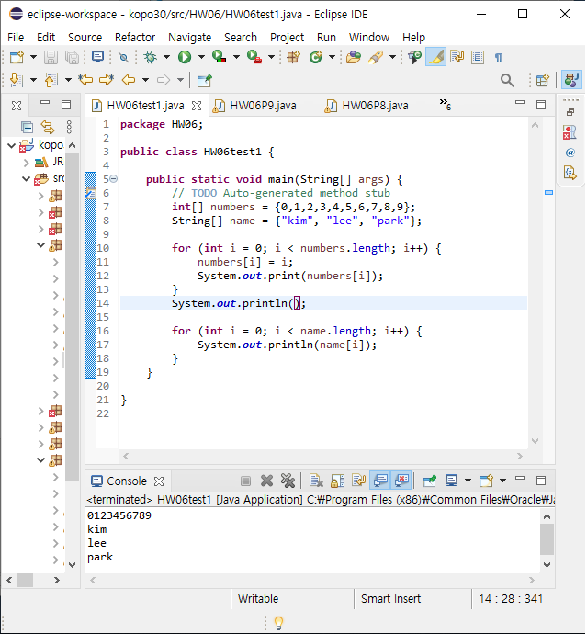
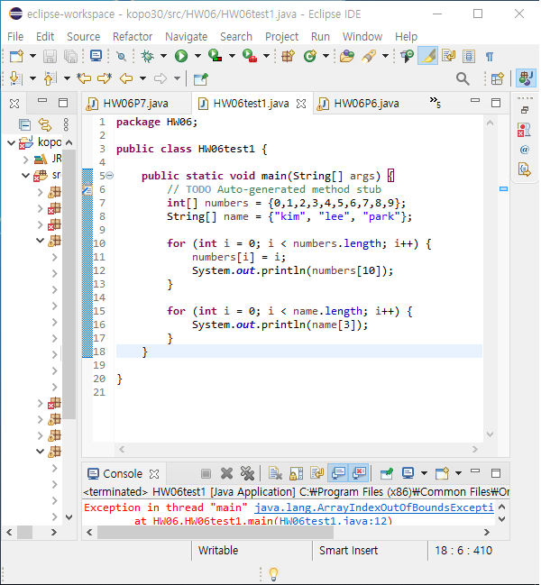
P1 : Print “number[10]” and “name[3]”

Slide 3
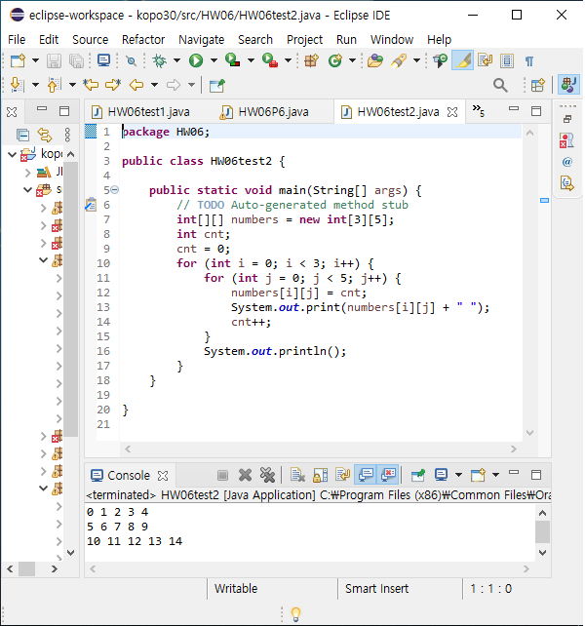
P2 : Print the array “numbers[][]”

Slide 4
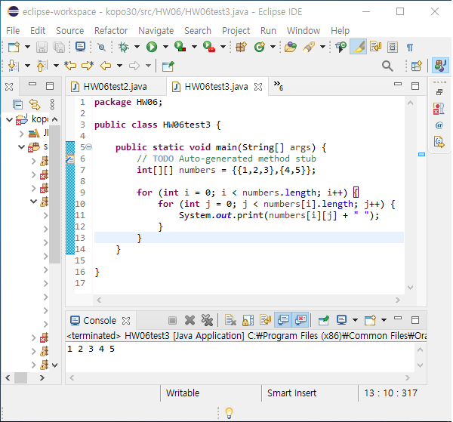
P3 : Print the array “numbers[][]”

Slide 5
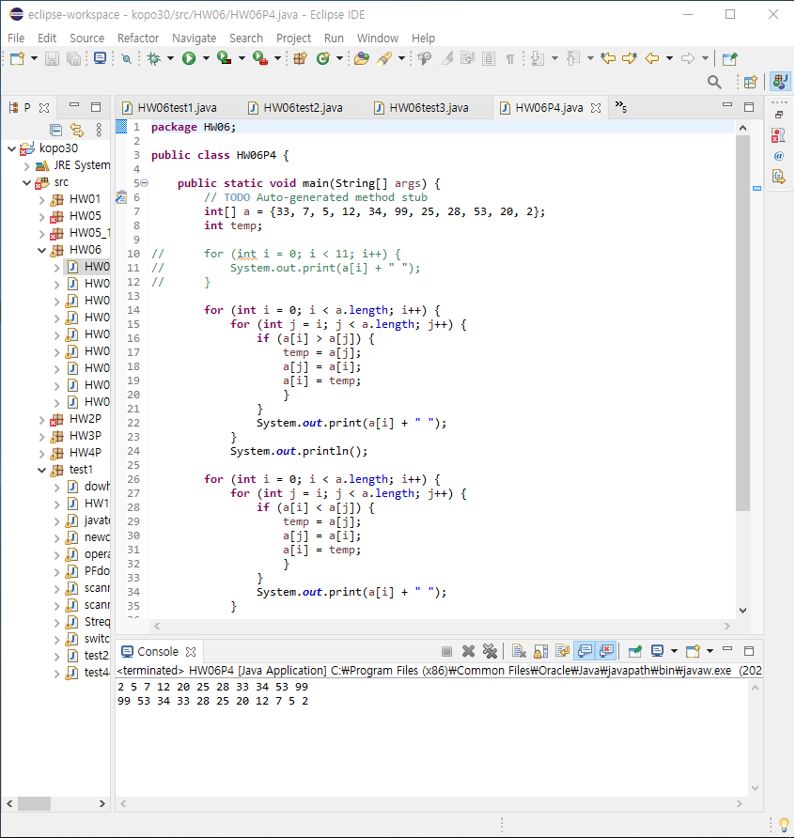
P4 : Sort

Slide 6
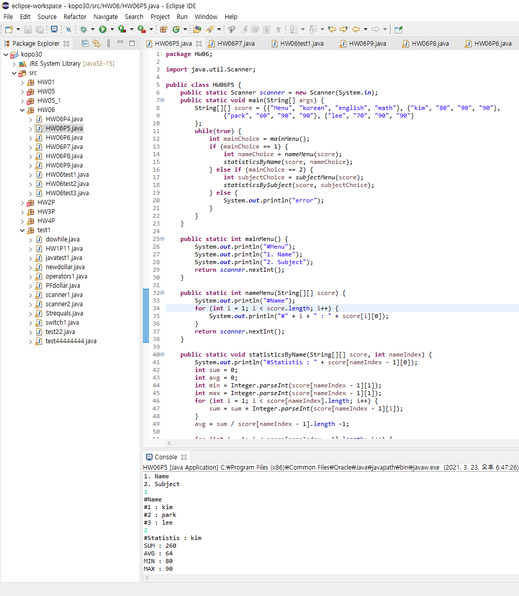
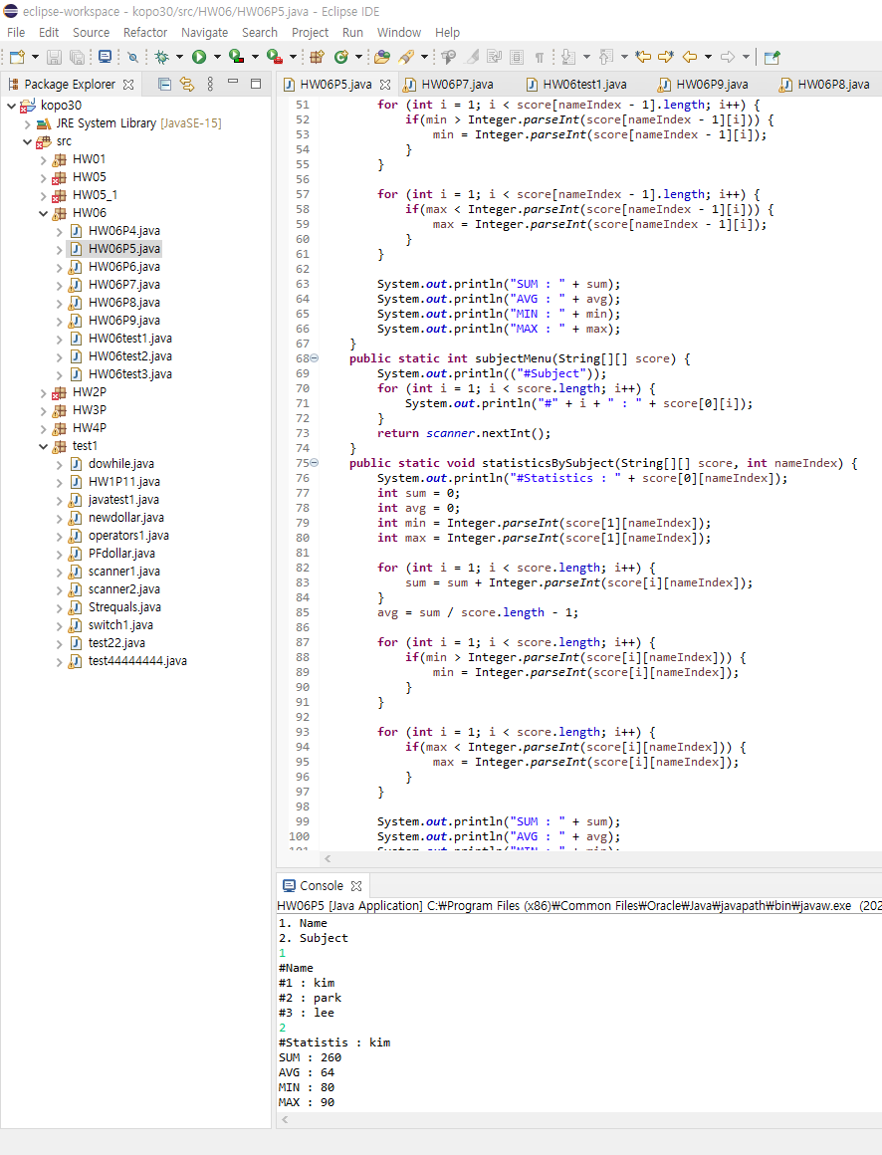
P5 : Descriptive Statistics

Slide 7
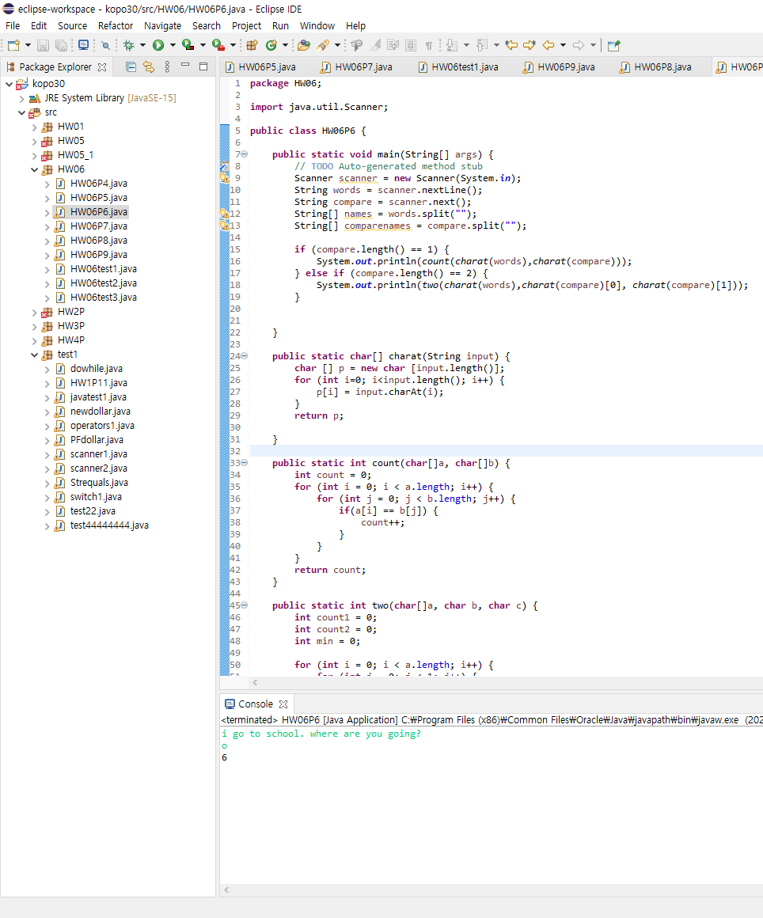
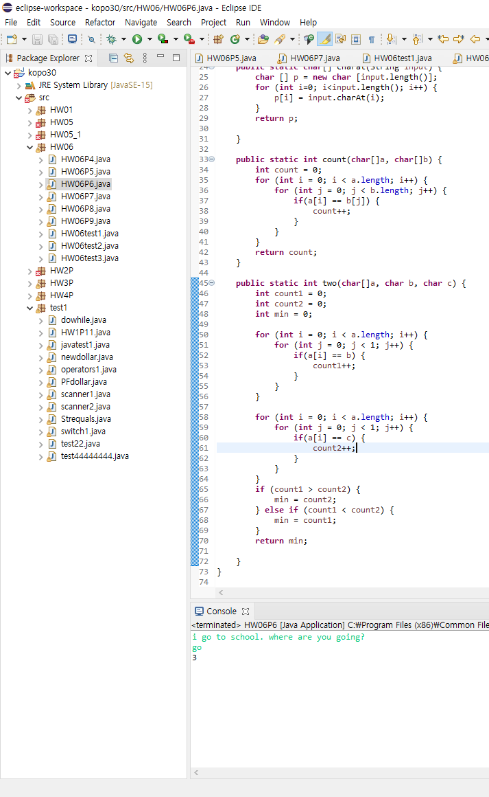
P6 : Counting a Specified Character

Slide 8
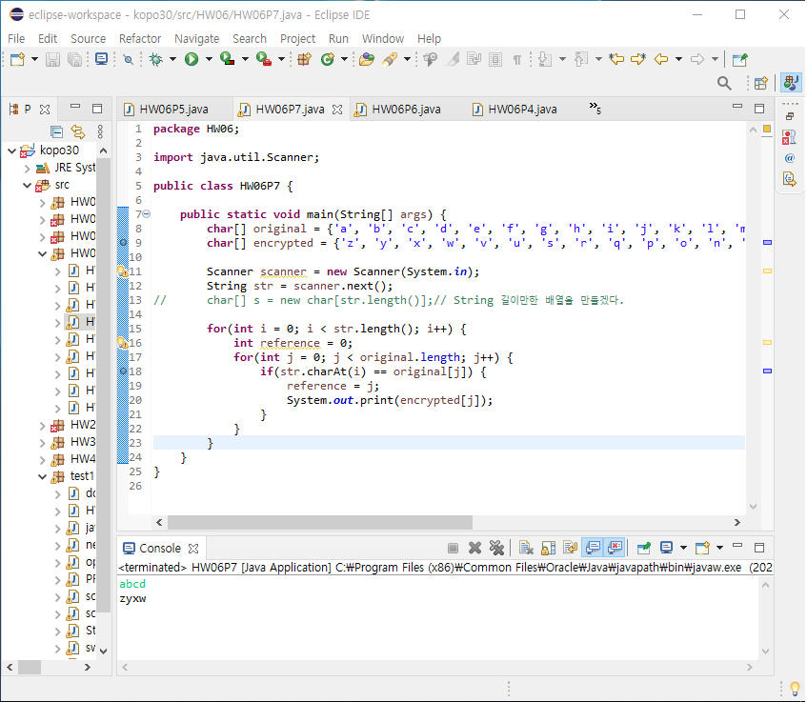
P7 : Encryption

Slide 9
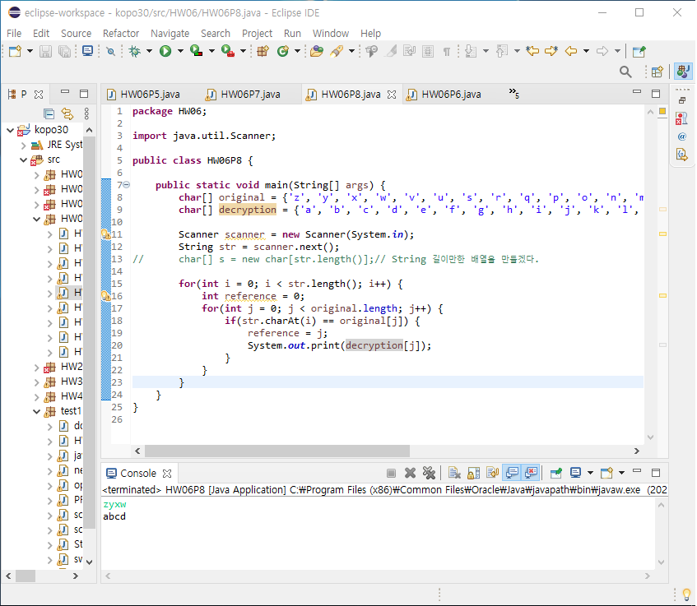
P8 : Decryption

Slide 10
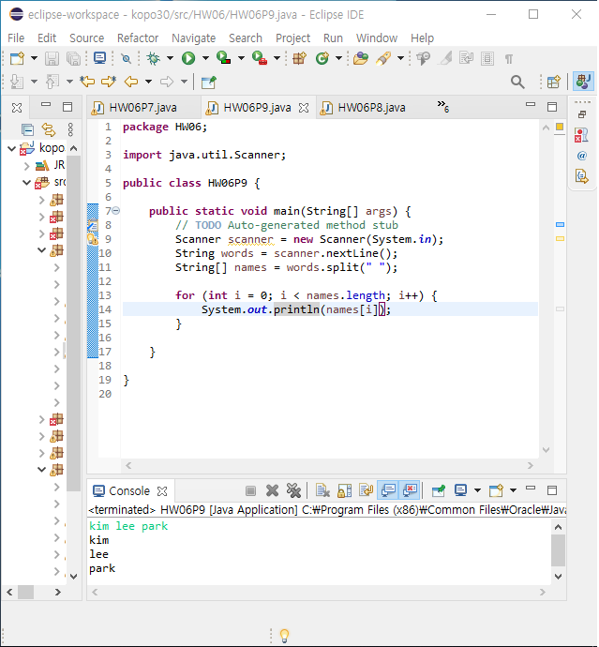
P9 : split()

